Slide 1
Curriculum Maps, Program Coherence, and Enhancement of Learner-Centered Approaches to Program Outcomes
Dr. Deborah Vess Vice President for Academic Affairs
August 19, 2015
Fall Faculty Meeting
Kristin McDonald-Willey Director of Institutional Effectiveness

Slide 2
Copious Note Taking

Slide 3
Learning Discussion
Surface, Strategic, and Deep Learning – What’s the Difference?
Surface – Read to remember (regurgitate)
Strategic – Goal: Survive and memorize (driven by grades)
Deep Learning – Seek understanding for meaning and context
Group Questions (Groups of 2)
What motivates you to take a deep approach to learning? (30 secs. to think; 30 seconds to share)
What are barriers that keep students from deep learning? (Brain dump – 30 seconds to think; 1 minute to dump)
Does the student think the question is important? (Try to create meaning)

Slide 4
Goals Exercise
Create program-level goals that include the following:
Incorporate higher-level Bloom’s Taxonomy verbs
Incorporate general education competencies
Incorporate high-impact practices
Purpose:
SACS-COC says so (Core Requirement 2.7.2 – coherent course of study; 3.3.1 – program outcomes; etc.)
Good educational practice
Encourage deeper student learning

Slide 5
Goals vs. Outcomes
Primary Issue with AC Goal Statements
Goal statement included too many different measurable components (i.e. goal paragraph)
Goal statement represented an outcome or multiple outcomes
Reminder:
Goal – Broad overlying statement of what you want to accomplish
Outcome – More specific statement aligns with goal
Who? – The students
Will… – analyze, solve, etc.
What? – The effects of the civil war, an algebraic equation with two unknowns, etc.
Other considerations: Attainment Target, measurement standard, and how measured

Slide 6
Curriculum Map
Focused on Learning Outcomes
Ensures coherent curriculum
Ensures ongoing practice of learned skills
Ensures gradual sophistication and application of what is learned
Means to collect evidence, assess evidence, and determine mastery of outcomes and ultimately of goals
Students will follow professional ethical standards when providing nursing care to patients
Students will analyze and interpret data in biological experiments
Students can audit financial records
Etc.

Slide 7
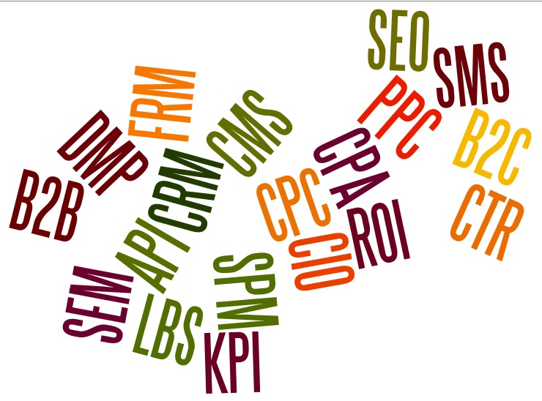
PLOs vs. CLOs
Two Levels of Outcomes
Program Learning Outcomes (PLOs): Students who complete this program can...
Course Learning Outcomes (CLOs): Students who complete this course can…

Slide 8
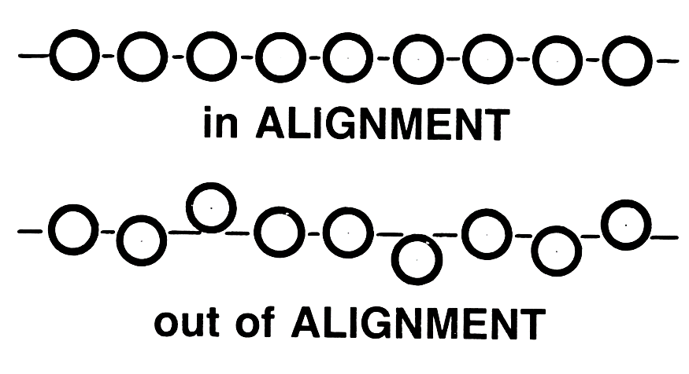
One Element of Coherent Alignment: Alignment with Mission
Goals should align with College Mission – Who we are
Goals should align with Program Mission – Who you are

Slide 9
Group Discussion – Mission Alignment
PSYCHOLOGY Mission: The mission of the Department of Psychology is to promote the understanding of self and others in a multi-cultural environment and to develop research and communication skills. We prepare students for careers requiring a strong liberal arts foundation with an emphasis on an understanding of intrapersonal and interpersonal dynamics and empirical methodology, and we prepare students for graduate study in Psychology.
Learning Goals and Outcomes:
Goal 1: To graduate students who apply psychological concepts and theories 1.1. Students will describe major concepts and theories in Psychology 1.2. Students will apply major concepts and theories to describe or explain psychological phenomena
Goal 2: To graduate students who demonstrate sound research methodology 2.1. Students will design basic research studies 2.2. Students will explain ethical issues relevant to psychological research. 2.3. Students will conduct literature reviews in psychology
Goal 3: To graduate students who demonstrate communication skills 3.1. Students will write papers in APA style 3.2. Students will give formal oral presentations on psychological topics

Slide 10
Group Discussion – Mission Alignment
PSYCHOLOGY Mission: The mission of the Department of Psychology is to promote the understanding of self and others in a multi-cultural environment and to develop research and communication skills. We prepare students for careers requiring a strong liberal arts foundation with an emphasis on an understanding of intrapersonal and interpersonal dynamics and empirical methodology, and we prepare students for graduate study in Psychology. It is not clear that things such as highlighted text are reinforced through goals/outcomes. Also a question as to if these are “real” (SMART) goals in mission or aspirational things that can’t be easily measured.
Learning Goals and Outcomes:
Goal 1: To graduate students who apply psychological concepts and theories 1.1. Students will describe major concepts and theories in Psychology 1.2. Students will apply major concepts and theories to describe or explain psychological phenomena
Goal 2: To graduate students who demonstrate sound research methodology 2.1. Students will design basic research studies 2.2. Students will explain ethical issues relevant to psychological research. 2.3. Students will conduct literature reviews in psychology
Goal 3: To graduate students who demonstrate communication skills 3.1. Students will write papers in APA style 3.2. Students will give formal oral presentations on psychological topics

Slide 11
Program Learning Outcome (PLO) - Sample Map 1 Group Discussion
I = Introduced; D = Developed & Practiced with Feedback; M = Demonstrated at Mastery Level Appropriate for Graduation
Goal:
Course | PLO 1 | PLO 2 | PLO 3 | PLO 4 | PLO 5
100 | I, D |  |  |  | I
101 |  | I | D |  | D
102 | D |  |  |  | D
103 |  |  | D |  | D
200 | D
229 |  |  | D, M |  | D
230 |  |  |  |  | M
280 |  |  | D, M
290 | M |  |  |  | M

Slide 12
Some Problems with Sample Map 1
I = Introduced; D = Developed & Practiced with Feedback; M = Demonstrated at Mastery Level Appropriate for Graduation
Goal:
Course | PLO 1 | PLO 2 | PLO 3 | PLO 4 | PLO 5
100 | I, D |  | I? |  | I
101 |  | I | D |  | D
102 | D |  |  | Whoops? | D
103 |  | Is | D |  | D
200 | D | PLO 2
229 |  | Ever | D, M |  | D
230 |  | Mentioned |  |  | M
280 |  | Again? | D, M |  | Too much?
290 | M |  |  |  | M

Slide 13
Program Learning Outcome (PLO) - Sample Map 2 Group Discussion
I = Introduced; D = Developed & Practiced with Feedback; M = Demonstrated at Mastery Level Appropriate for Graduation
Goal:
Course | PLO 1 | PLO 2 | PLO 3 | PLO 4 | PLO 5
100 | I
101 | D, M
102 |  | I, D, M
103 |  |  | I, D
200 |  |  | D, M
229 |  |  |  | I, D, M
230 |  |  |  |  | I, D, M

Slide 14
Some Problems with Sample Map 2
I = Introduced; D = Developed & Practiced with Feedback; M = Demonstrated at Mastery Level Appropriate for Graduation
Goal:
Course | PLO 1 | PLO 2 | PLO 3 | PLO 4 | PLO 5
100 | I |  |  | Course | Silos?
101 | D, M
102 |  | I, D, M
103 |  |  | I, D
200 |  |  | D, M
229 | CLOs | Pretending |  | I, D, M
230 | to be | PLOs? |  |  | I, D, M

Slide 15
Program Learning Outcome (PLO) - Sample Map 3 Group Discussion
I = Introduced; D = Developed & Practiced with Feedback; M = Demonstrated at Mastery Level Appropriate for Graduation
Goal
Course | PLO 1 | PLO 2 | PLO 3 | PLO 4 | PLO 5
100 | I | I | I | I | I
101 | D | D | D | D | D
102 | D | D | D | D | D
103 | D | D | D | D | D
200 | D | D | D | D | D
229 | D | D | D | D | D
230 | M | M | M | M | M

Slide 16
Some Problems with Sample Map 3
I = Introduced; D = Developed & Practiced with Feedback; M = Demonstrated at Mastery Level Appropriate for Graduation
Goal
Course | PLO 1 | PLO 2 | PLO 3 | PLO 4 | PLO 5
100 | I | I | I | I | I
101 | D | D | D | D | D
102 | D | D | D | D | D
103 | D | D | D | D | D
200 | D | D | D | D | D
229 | D | D | D | D | D
230 | M | M | M | M | M
Less is More! Focus on students doing some things really well in each course. Some exceptions: Example – In Nursing, patient care may be woven throughout curriculum

Slide 17
What Should my PLO Curriculum Map Look Like?
Every PLO should be:
I (Introduced)
D (Developed and practiced with feedback) – Should have evidence!
M (Demonstrated at Mastery Level) – Should have evidence!
Stackable credentials can be worked into overall curriculum map
PLOs should demonstrate coherent curriculum
Not mentioned a few times and forgotten
Students should graduate with full development/mastery of more than one PLO

Slide 18
AC Curriculum Map – Get Handout (Template will also be sent via email)
Goal #1:
Program-Specific Courses | PLO #1: | PLO #2: | PLO #3: | PLO #4: | PLO #5:
I = Introduced; D = Developed & Practiced with Feedback; M = Demonstrated at Mastery

Slide 19
AC Curriculum Map – Get Handout (Template will also be sent via email)
Goal #1: To graduate students who demonstrate communication skills
Program-Specific Courses | PLO #1: Students will compose APA-style papers | PLO #2: Students will produce oral presentations on psychological topics
Course 1
Course 2
Course 3
Course 4
Once courses added, the key that would be used to evaluate the courses is shown below:
I = Introduced; D = Developed & Practiced with Feedback; M = Demonstrated at Mastery

Slide 20
How does this affect my courses?
Based on PLOs, you may need to tweak PLOs in various courses
Can further explore in departments to look at CLO alignment
Affects Teaching Methods
Active Learning
Collaborative/Cooperative Learning
Community Service Learning
Homework/Lab Assignments
Etc.
Affects High-Impact Educational Practices in the Classroom
Common Intellectual Experiences
Learning Communities
Service Learning, Community-Based Learning
Etc.

Slide 21
CLO Example – Discussion (Questions?)
 | CLO 1 | CLO 2 | CLO 3 | CLO 4 | CLO 5
Class 1
Class 2 |  | X
Class 3 | X | X | X
Class 4 | X | X | X
Class 5 | X | X
Class 6 |  | X |  |  | X
Class 7 |  | X |  |  | X
Class 8
Reading 1 | X |  | X
Reading 2 |  |  |  |  | X
HW 1
HW 2 |  |  | X |  | X
Midterm | X | X | X | X | X
Final Exam |  |  | X |  | X

Slide 22
CLO Example
 | CLO 1 | CLO 2 | CLO 3 | CLO 4 | CLO 5
Class 1 |  |  |  | Never
Class 2 |  | X |  | Introduced?
Class 3 | X | X | X
Class 4 | X | X | X
Class 5 |  | X
Class 6 | Introduced | X |  |  | X
Class 7 | And | X |  |  | X
Class 8 | Forgotten?
Reading 1 |  | Never | Never | Never
Reading 2 |  | Reinforced? | Reinforced? | Reinforced? | X
HW 1 |  | Never |  | Never
HW 2 |  | Practiced? | X | Practiced? | X
Midterm |  | X | X | X | X
Final Exam |  |  | X |  | X

Slide 23
What Now?
September 1st – Submit any Program Goal Edits to Director of IE or Set Appointment by September 1st to Finalize Goals
December 1st – Submit AC Program Learning Outcome (PLO) Curriculum Map
NOTE: THE CLO map shown on the previous two slides is provided as an example so that you can see some broader capabilities of curriculum mapping.
You are required to present the PLO curriculum maps (slides 8-19; separate AC PLO Curriculum Map handout) to the Director of Institutional Effectiveness, but are not required to present CLO curriculum maps (slides 21-22) to the Director of Institutional Effectiveness.
However, at the department and course level, you can use the CLO mapping process to improve your course design and your student’s attainment of course learning outcomes.

Slide 24
Primary Sources
AC Discussions; Goals/Outcomes Handouts; Goals Rubric
SACS – COC Summer Conference: Ken Bain and Mary J. Allen Materials
Mary J. Allen
Alllen, M.J. (2004). Assessing academic programs in higher education. San Francisco: Jossey-Bass.
Allen, M.J. (2006). Assessing general education programs in higher education. San Francisco: Jossey-Bass.
Ken Bain
Twitter – kenbain1
http://www.psychologytoday.com/blog/what-the-best-college-students-do

